Slide 1
Light from the Galactic Plane November 28, 2015
by
LeRoy Larry

Slide 2
Notes:
Has anyone here ever seen the movie “Predator”?
Good movie - from the 80’s. The alien wore a helmet which allowed it to see in different wavelengths of light - optical, x-ray, infrared, ultraviolet…

Slide 3
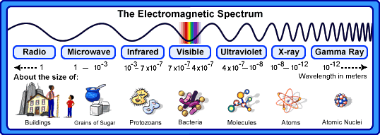
Notes:
Going from the longest wavelength, corresponding to the lowest frequency and in turn to the lowest energy - to the shortest wavelength, corresponding to the highest frequency and in turn to the highest energy,, the electromagnetic spectrum consists of the ranges:
radio - microwave - infrared – optical - ultraviolet - x-ray - gamma-ray

Slide 4
Notes:
The visible range in which we see is a small part of the electromagnetic spectrum.

Slide 5
Notes:
Just as a group of six runners clasping arms will break apart when running from the beach into the ocean,

Slide 6
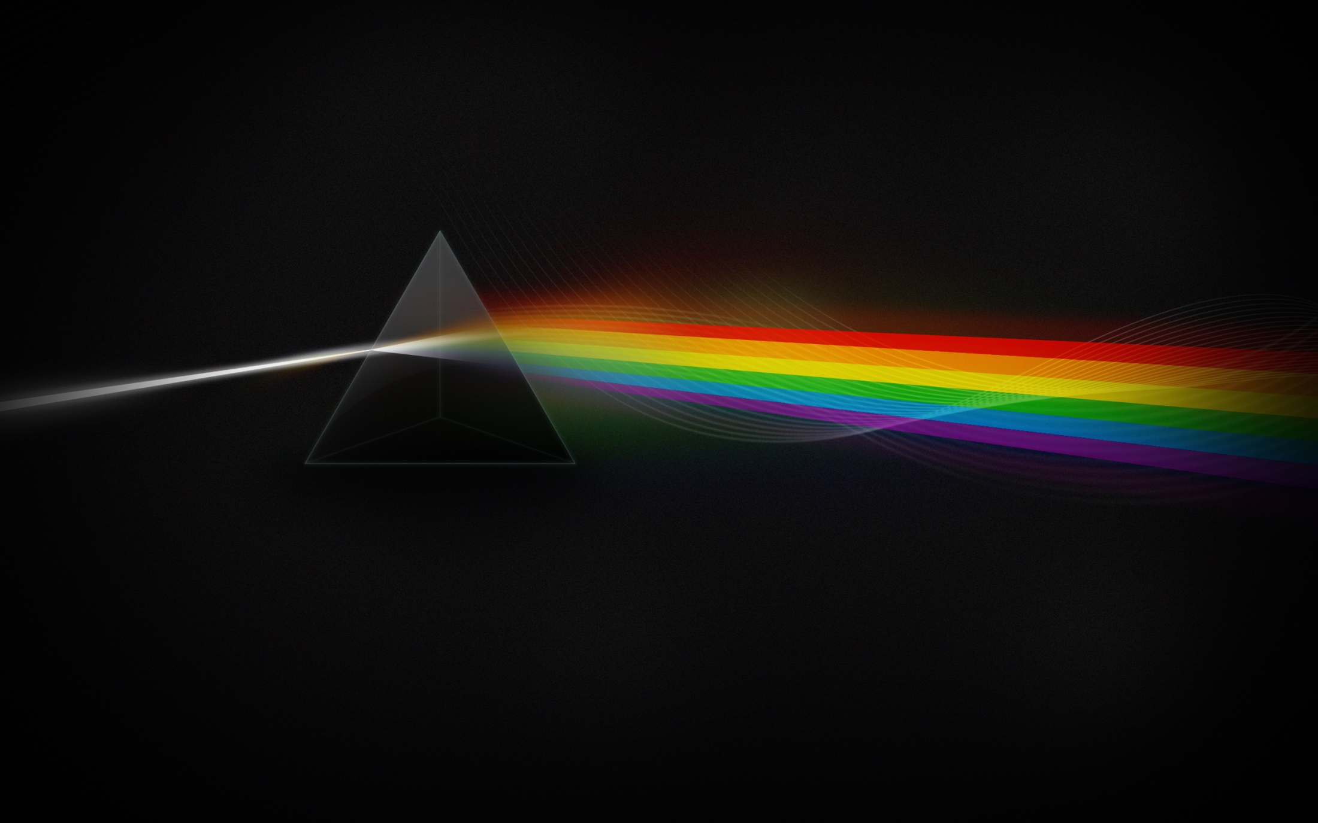
Notes:
a beam of light breaks-up into the six major colors of red, orange, yellow, green, blue, and violet,

Slide 7
Notes:
because these colors travel at different velocities when traveling from one medium into another.

Slide 8
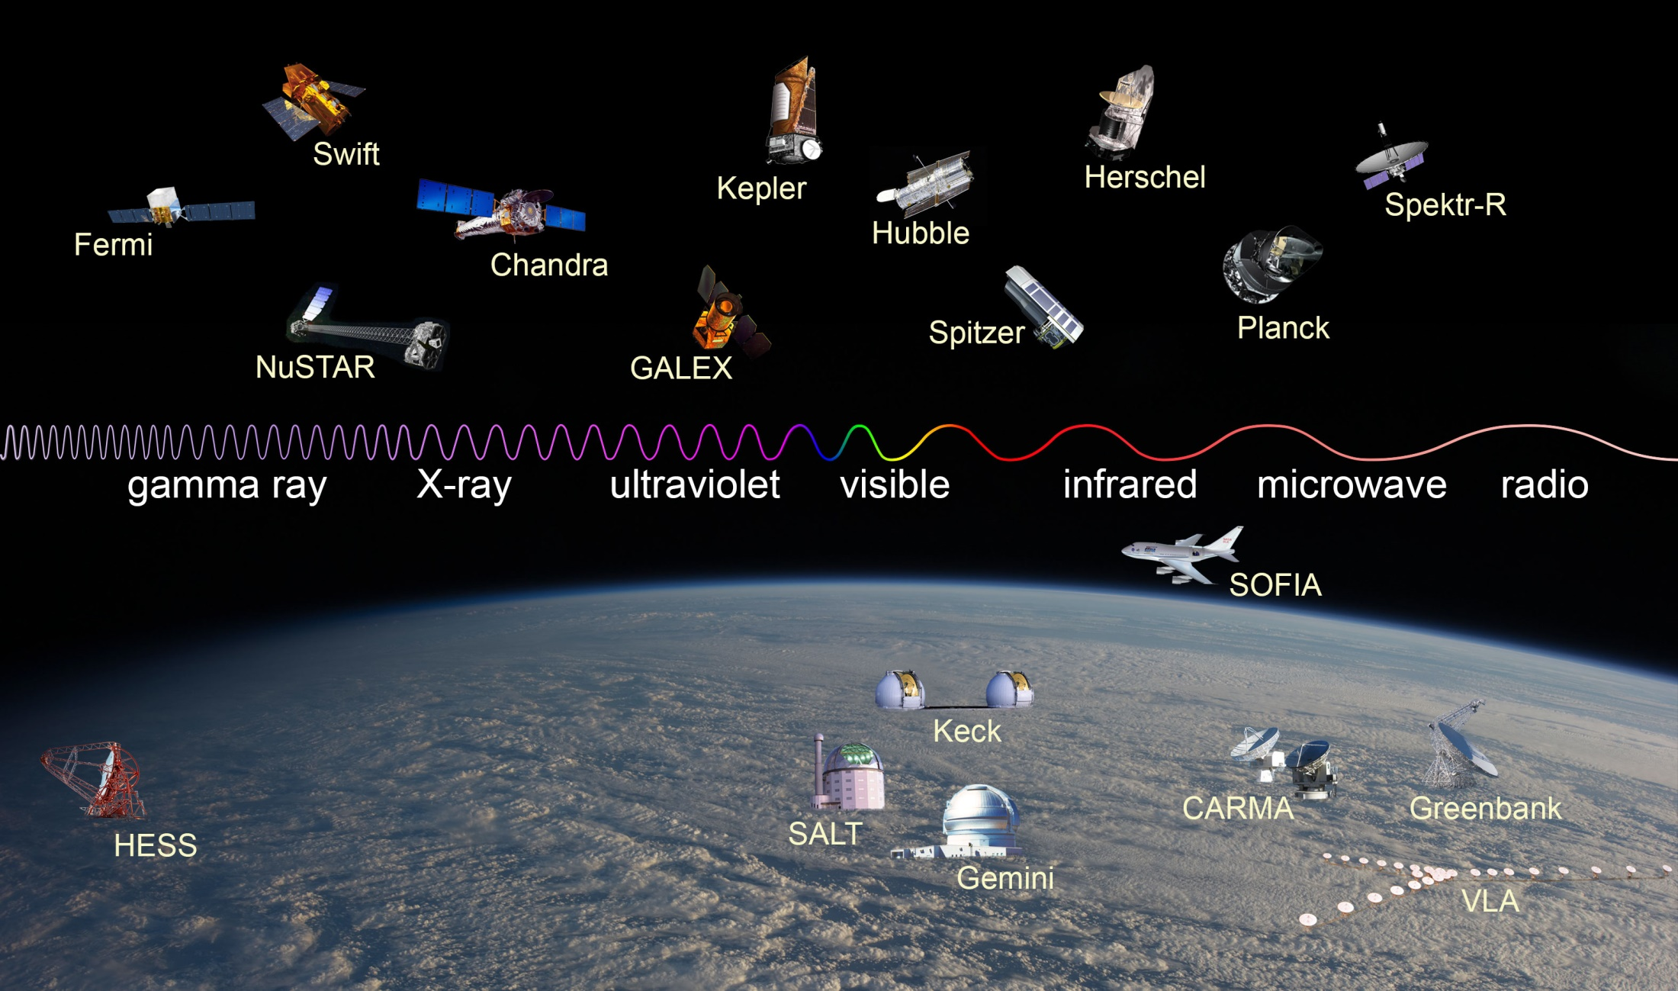
Notes:
We may not have a helmet like the Predator, but we do have ground-based telescopes, and space telescopes orbiting high above the Earth’s obscuring atmosphere, which do allow us to look into outer space with different “eyes” that enable us to “see” in the different wavelengths of light.

Slide 9
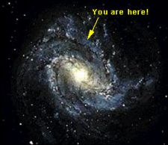
Notes:
Because no space probe has yet left our galaxy to take a photograph or “selfie” we do not know what our galaxy looks like from the outside, only from the inside.
Based on data from other galaxies our galaxy is believed to be a spiral galaxy.

Slide 10
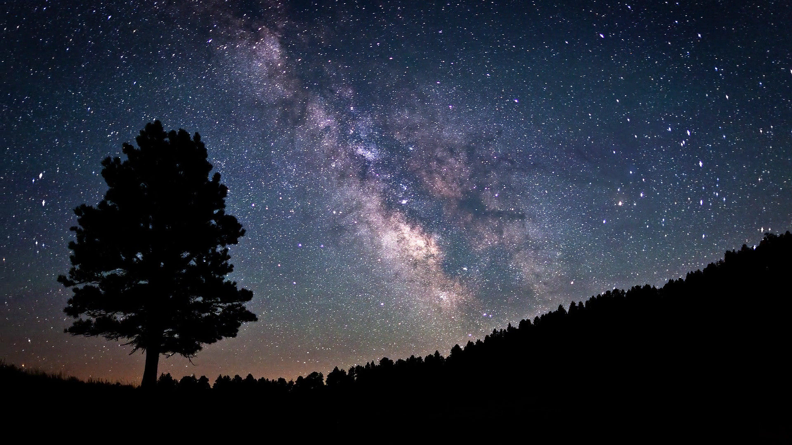
Notes:
“A long time ago, in a galaxy far, far away” - I was in the Boy Scouts.
We went camping far away from the city lights, and I remember looking up at the Milky Way.
It really did look like milk had been spilled across the night sky!
I did not know it then, but I was looking along the galactic plane towards the center of our Milky Way Galaxy.

Slide 11
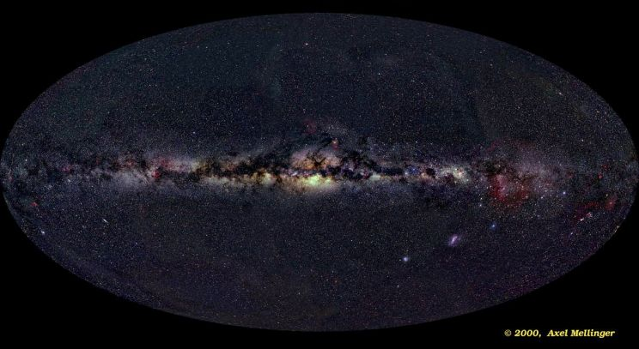
Notes:
This is a view of the galactic plane of our Milky Way Galaxy in the optical range of the electromagnetic spectrum.
“Milky" bands of starlight from the multitude of stars in the galactic plane are cut by the dark, obscuring dust clouds strewn through the local spiral arms.
Almost everything visible is within the Milky Way Galaxy.
Two fuzzy patches in the lower right quadrant of the mosaic correspond to external galaxies known as the Magellanic Clouds, these are small, nearby satellite galaxies of our Milky Way Galaxy.

Slide 12
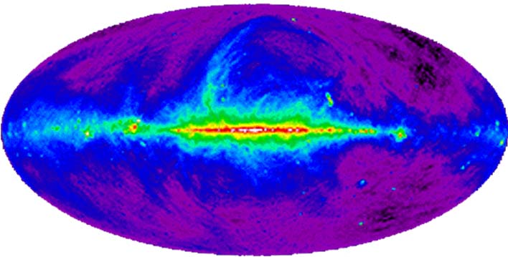
Notes:
The following are views of our galactic plane in the radio, microwave, infrared, ultraviolet, x-ray, and gamma-ray wavelengths of the electromagnetic spectrum.
Each range provides unique information about our Milky Way Galaxy.
Tune a radio telescope to 408MHz (408 million cycles per second), frequency on your dial somewhere between US broadcast television channels 13 and 14. In the 1970s large dish antennas at radio observatories were used to do just that.
Near this frequency, cosmic radio waves are generated by high energy electrons spiraling along magnetic fields.
In the image no stars are visible, many of the bright sources near the plane are distant pulsars, star forming regions, and supernova remnants, while the grand looping structures are pieces of bubbles blown by local stellar activity.
External galaxies like Centaurus A, located above the plane to the right of center, and the LMC (Large Magellanic Cloud), below and right, also shine in the Radio Sky.

Slide 13
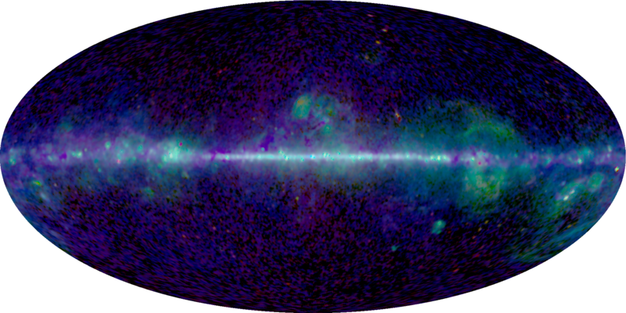
Notes:
The bright stripe of gas and dust clouds along the galactic plane and the galaxy's enormous arcing structures seen at microwave energies are hundreds or thousands of light-years away,
The mottled regions at the top and bottom represent the Cosmic Microwave Background (CMB) radiation, some 13.7 billion light-years distant.
Left over from the Big Bang, fluctuations in the CMB reflect the origins of structure in the evolving universe.
Analyzing the microwave data to separate the contributions of the Milky Way and CMB radiation will ferret out the characteristics of the CMB across the entire sky and glean information about the make up of our Milky Way Galaxy.

Slide 14
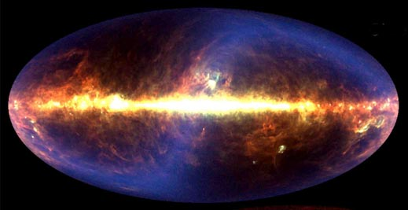
Notes:
Three major sources contribute to the infrared sky: our Solar System, our Galaxy, and our Universe.
Our Solar System is evidenced most prominently by the S-shaped blue sash called zodiacal light, created by small pieces of rock and dust orbiting between the Sun and Jupiter.
Our Galaxy is evidenced by the bright band of light that crosses the middle of the image, created mostly by dust that laces the disk of our Milky Way.
The background is not completely dark, indicating that our Universe itself provides a diffuse glow, created by the dust left over from the star formation throughout the Universe.

Slide 15
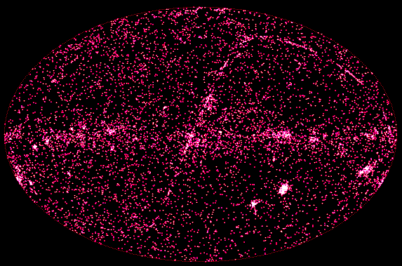
Notes:
How do planets, stars, and galaxies form? How do they evolve?
Answers to some of the most fundamental questions about the contents of our universe are found in the ultraviolet range.
This range reveals the positions of distant quasars, galaxies, stars, star clusters, nebulae, novae, and supernovae.
Again our Solar System is evidenced most prominently by the S-shaped sash called zodiacal light, created by small pieces of rock and dust orbiting between the Sun and Jupiter.
The ecliptic plane is also visible running diagonally through the center, traced out by many observations of solar system objects.

Slide 16
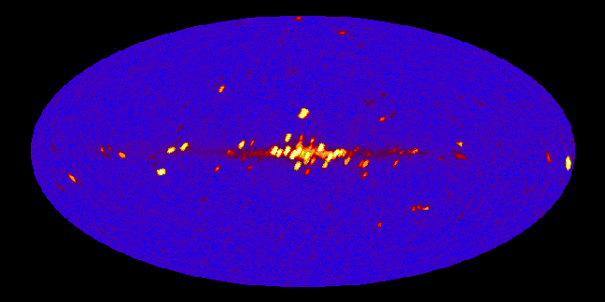
Notes:
What if you could see x-rays?
The night sky would be a strange and unfamiliar place.
X-rays are about 1,000 times more energetic than visible light photons and are produced in violent and high temperature astrophysical environments.
Instead of the familiar steady stars, the sky would seem to be filled with exotic binary star systems composed of white dwarfs, neutron stars, and black holes, along with flare stars, x-ray bursters, pulsars, supernova remnants and active galaxies.
Sources near the galactic center are seen to dominate.
Regions of highest x-ray intensity are in yellow.

Slide 17
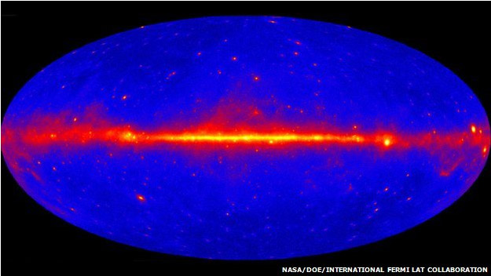
Notes:
This is data from my research using the “eyes” of the Fermi gamma-ray space telescope.
Gamma rays are the most powerful form of energy known to exist in Nature, more powerful than x-rays and microwaves.

Slide 18
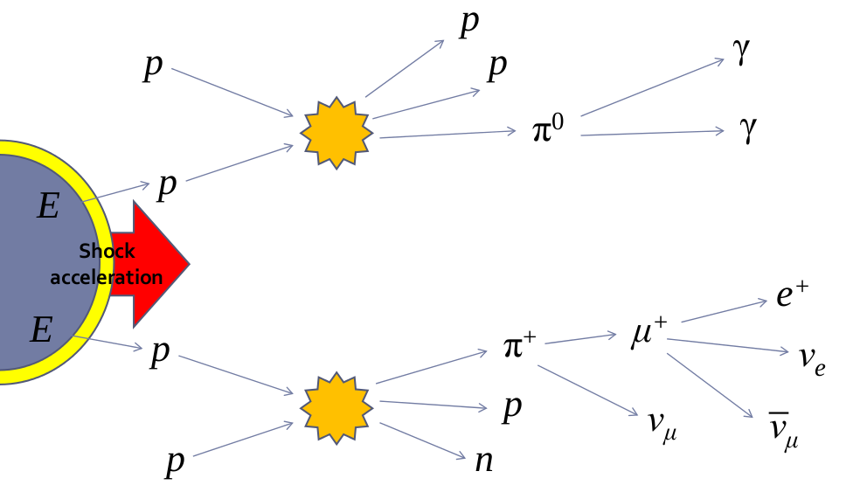
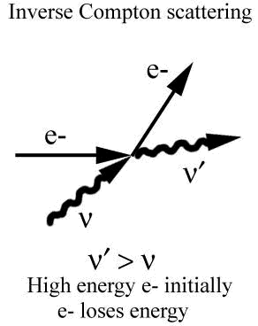
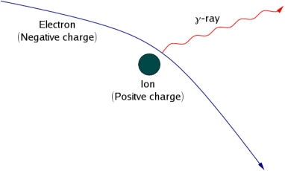
Neutral pion decay
Bremsstrahlung
Notes:
Gamma rays come from cosmic rays, and no one knows where cosmic rays come from.
Cosmic rays are tiny, electrically charged particles that move at nearly the speed of light.
They are primarily protons and most were probably accelerated to their incredible speeds by star explosions known as supernovas.
When cosmic rays collide with interstellar gas or photons of starlight, they give off gamma rays.

Slide 19
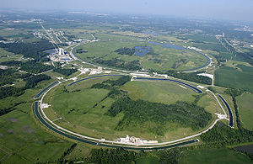
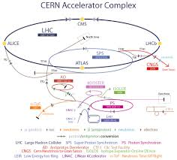
Fermilab Tevatron
CERN Large Hadron Collider (LHD)
circumference = 4.26 miles = 6.86 km
circumference = 17 miles = 27 km
1 TeV
13 TeV
Notes:
Here on Earth we have particle accelerators that can produce high energy protons.
The largest in the United States is the Fermilab Tevatron, with a circumference of 6.86 km, capable of producing protons with energies of 1 trillion electron volts (TeV).
The largest in the world is the CERN Large Hadron Collider (LHC) with a circumference of 27 km, capable of producing protons with energies of 13 TeV.
However cosmic-ray protons reach us with energies thousands of times greater.

Slide 20
Notes:
Here at CINESPA (Center for Space Research), we are looking for the source of cosmic rays by detecting gamma-ray emissions from supernova remnants (SNRs).

Slide 21
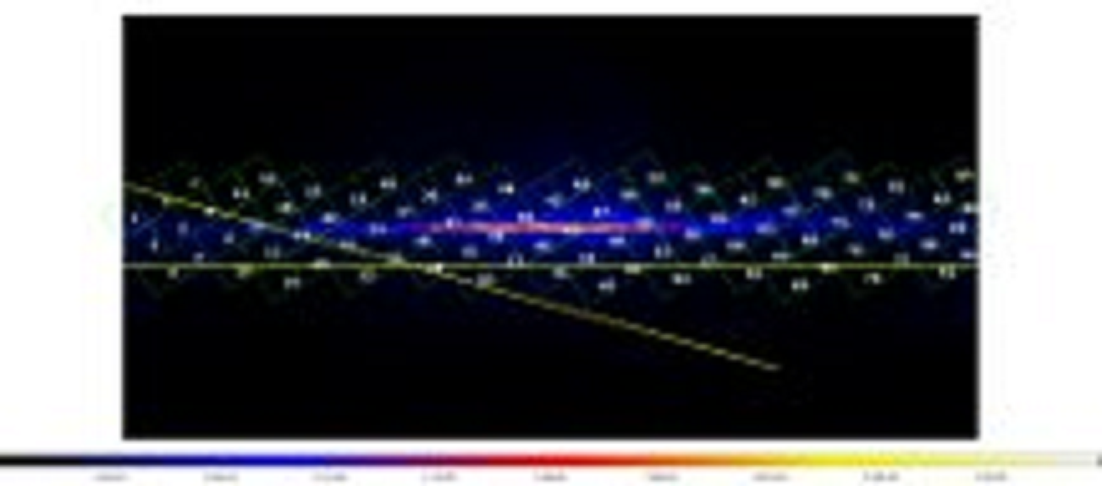
Milky Way Galactic Plane Region Map
110,000 ly = 660,000 trillion miles = 990,000 trillion km
Notes:
Our galactic plane is divided into 86 regions to detect as yet undiscovered gamma-ray sources.

Slide 22
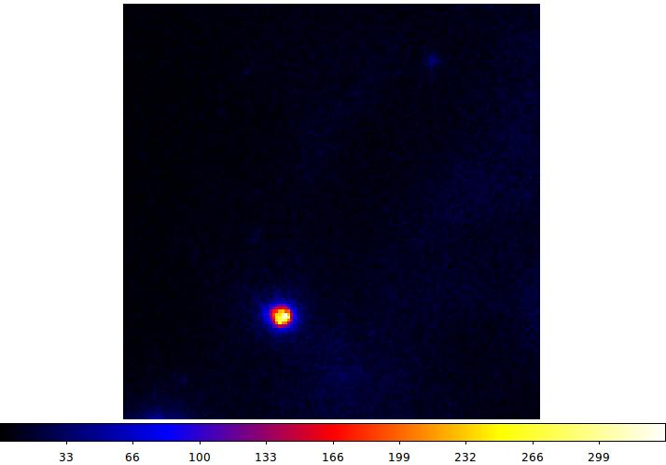
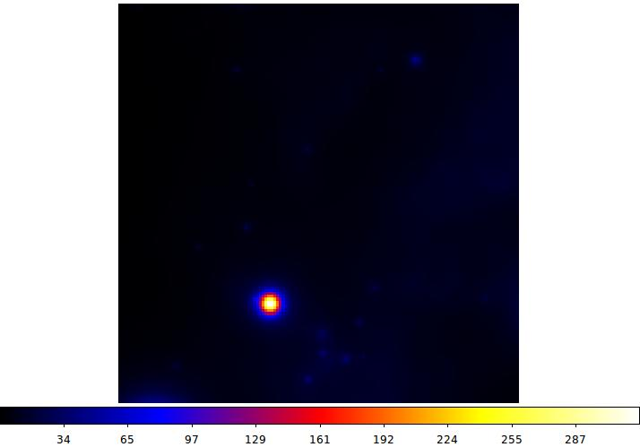
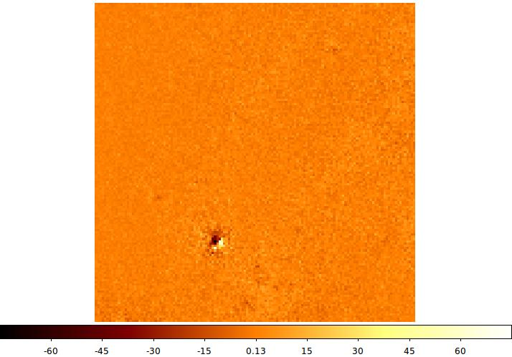
Region 1
Counts Map
Model Map
Residual Map
Notes:
Software programs are used to analyze and model the data.

Slide 23
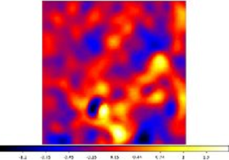
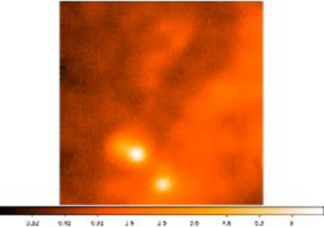
Region 1
Smoothed Residual map
Radio WMAP
Notes:
Here are indicated two “hot spots”, locations of potential new gamma-ray sources.

